Slide 1
Screen Sample for Final Project
Project Name: Fraction Runner
Team Harem:
Junquan Lin, Brandon Her,
Jose Acosta, John

Slide 2
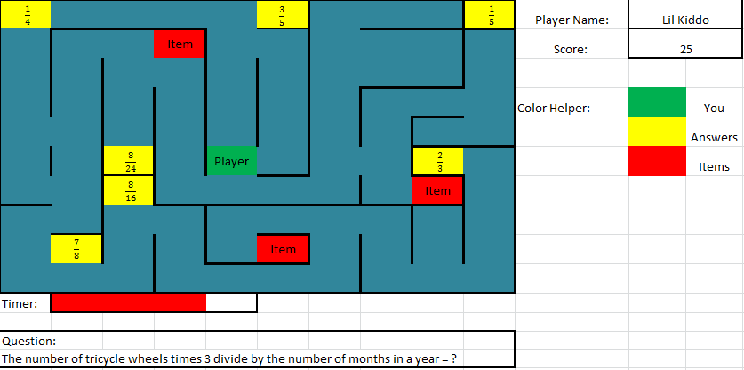
Floor One Maze

